Slide 1
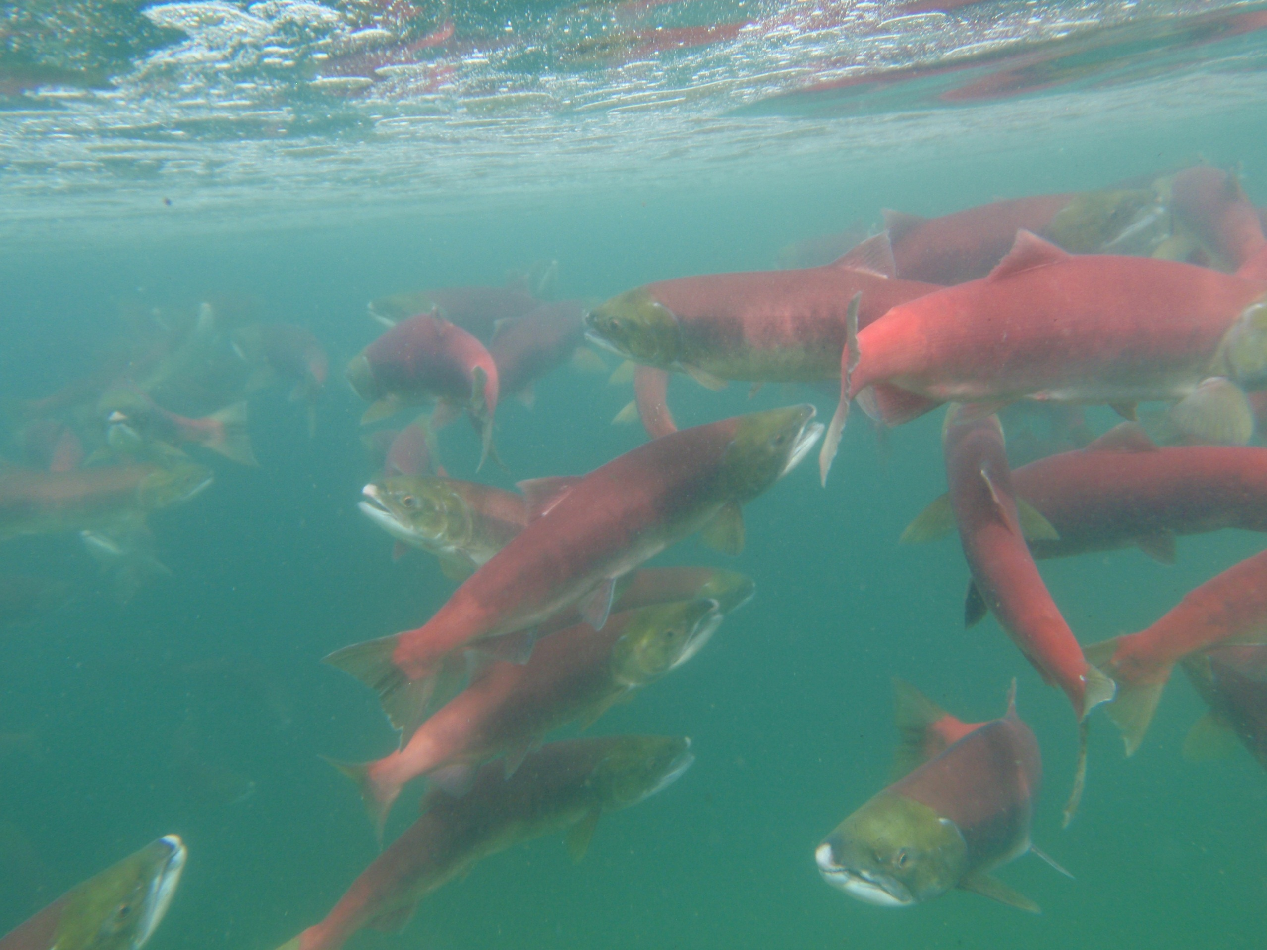
2016 Snake River Adult Sockeye Passage and Smolt Condition
Russ Kiefer
Idaho Department of Fish & Game

Slide 2
Passage Survival from Bonneville upstream: 2015

Slide 3
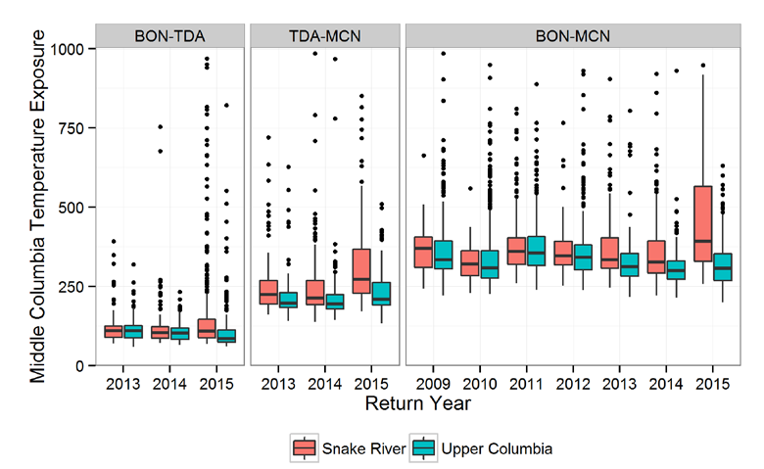
FPC Report: Temperature exposure from Bonneville to The Dalles, The Dalles to McNary, and Bonneville to McNary Dam by return year and origin.

Slide 4
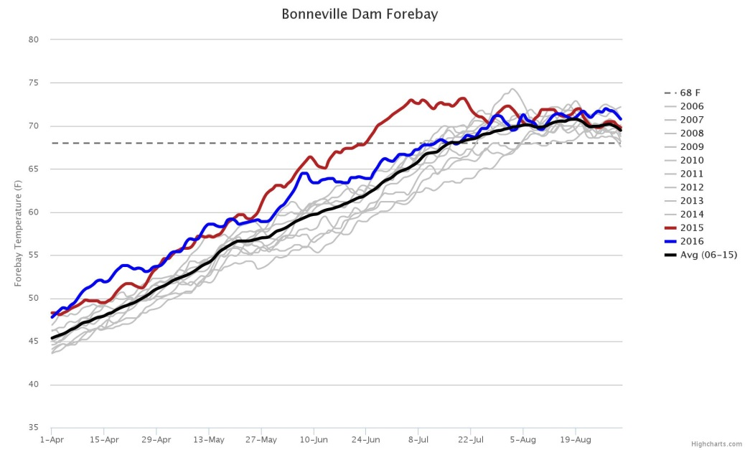
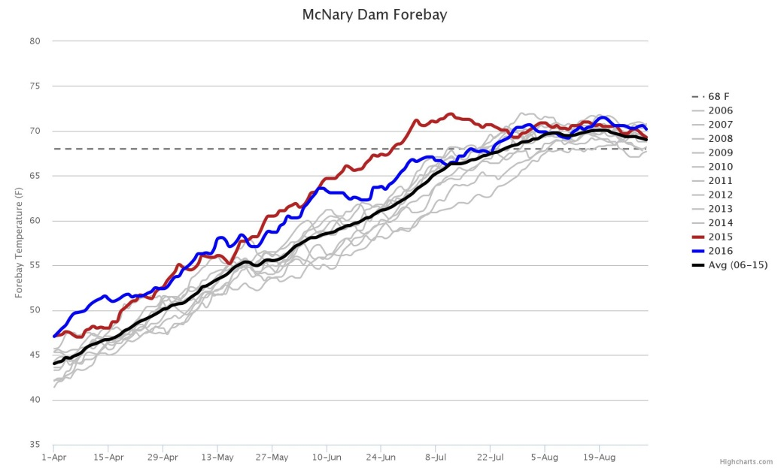
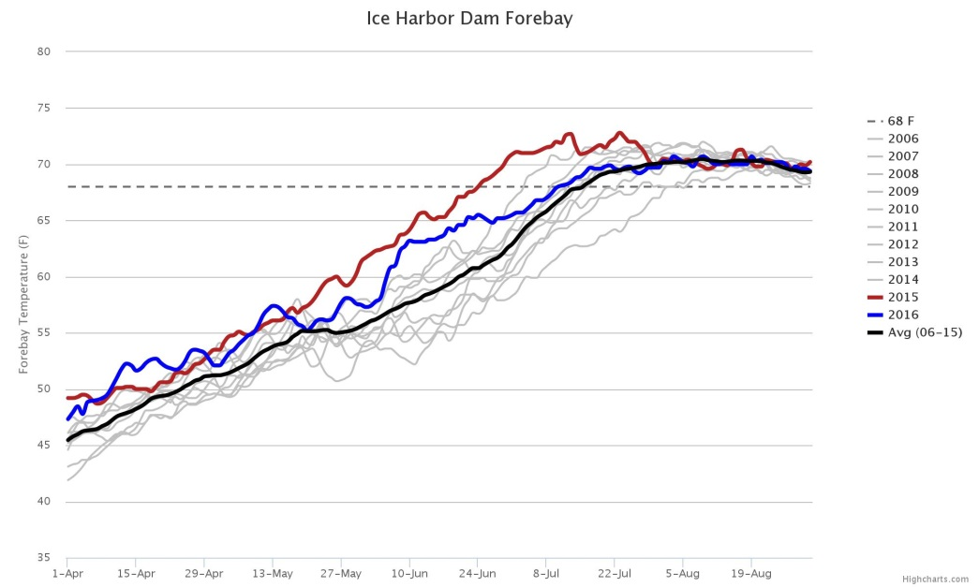
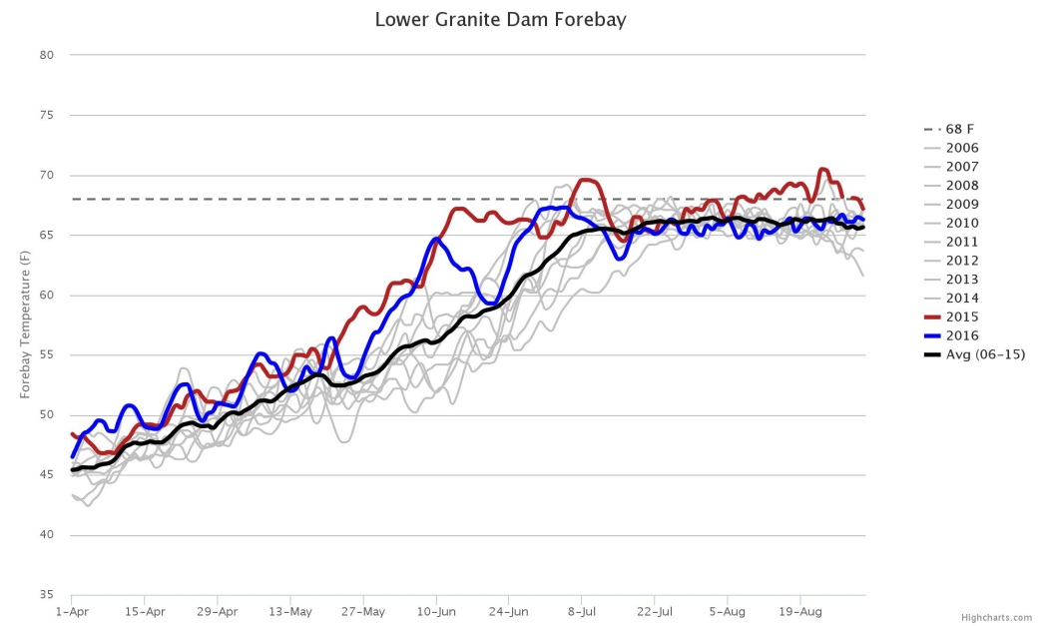
2016 Water Temperatures (FPC)

Slide 5
2015 & 2016 Run Sizes
Total sockeye BON return was ~500,000 in 2015 with a forecast of ~110,000 for 2016.
Total run size at BON was ~342,000 for 2016.
Snake River sockeye BON return was ~4,000 in 2015 with a forecast of 1,348 for 2016.
Updated run size at BON is ~ 1,032 for 2016.
Notes:
Update Snake Stuff

Slide 6
2016 Sockeye Salmon Passage
342,000
262,000
814
310,000
Notes:
Talk about conversion being good in 2016. Actual discrepancy between RIS & MCN due to fallback, lock use at MNC, and kokanee flushed out of FDR and counted as sockeye at RIS.

Slide 7
Ladder Temperature Improvements

Slide 8
LGR Ladder Improvements

Slide 9
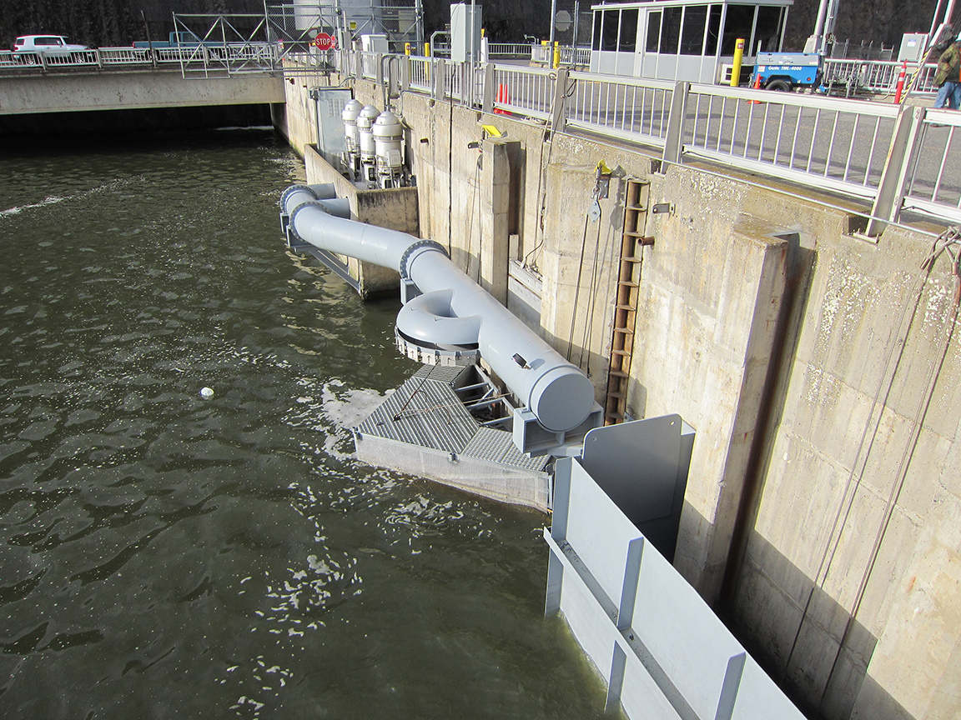
LGR Ladder Exit Shower

Slide 10
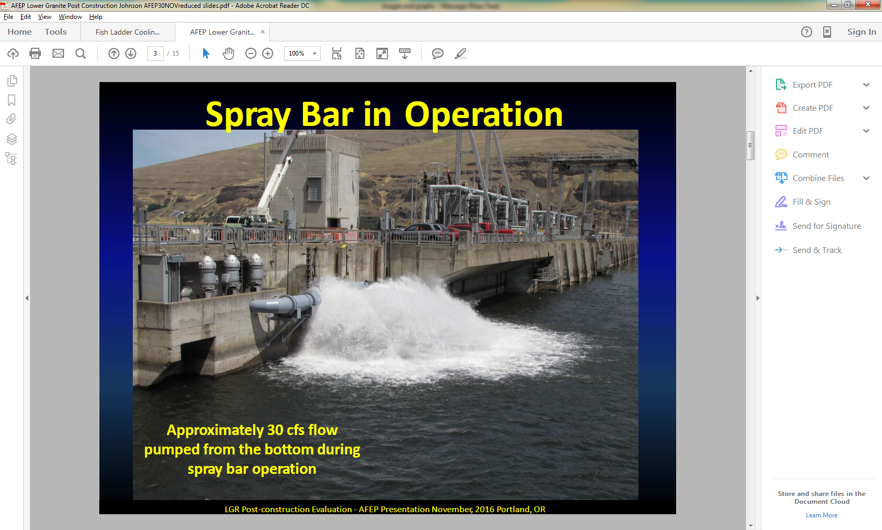
2015 Production Targets
Able to Release 494 adults into RFL and 98 adults into Pettit this year and meet natural production release targets
Able to Spawn >1500 adults to generate ~ 800K smolts for production
(2X more than any previous release)
Backed down 1M Smolt Release to release adults into natural environment
In the Future: Enough eggs are taken from captive broodstock each year to meet broodstock and production goals so should be able to meet targets with CB fish only
Anadromous fish confer fitness benefits to the program (especially if they made it in-river the entire way)
Approximately 50 cfs in flow

Slide 11
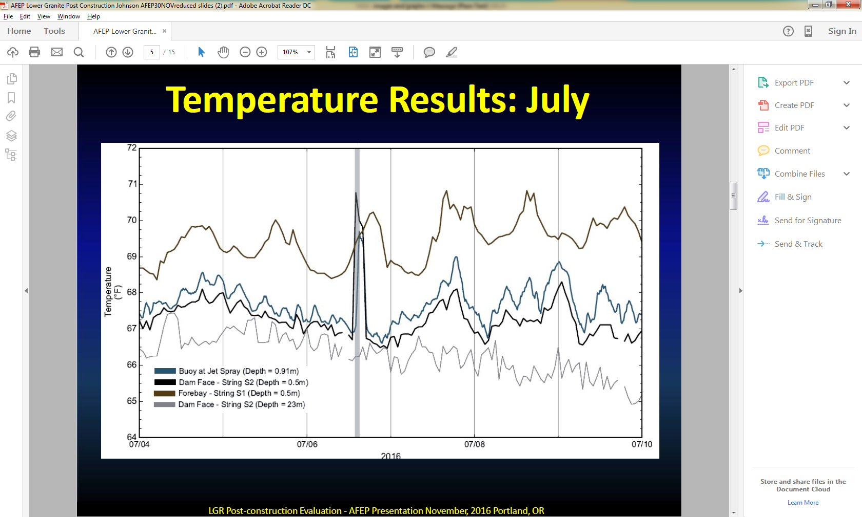

Slide 12
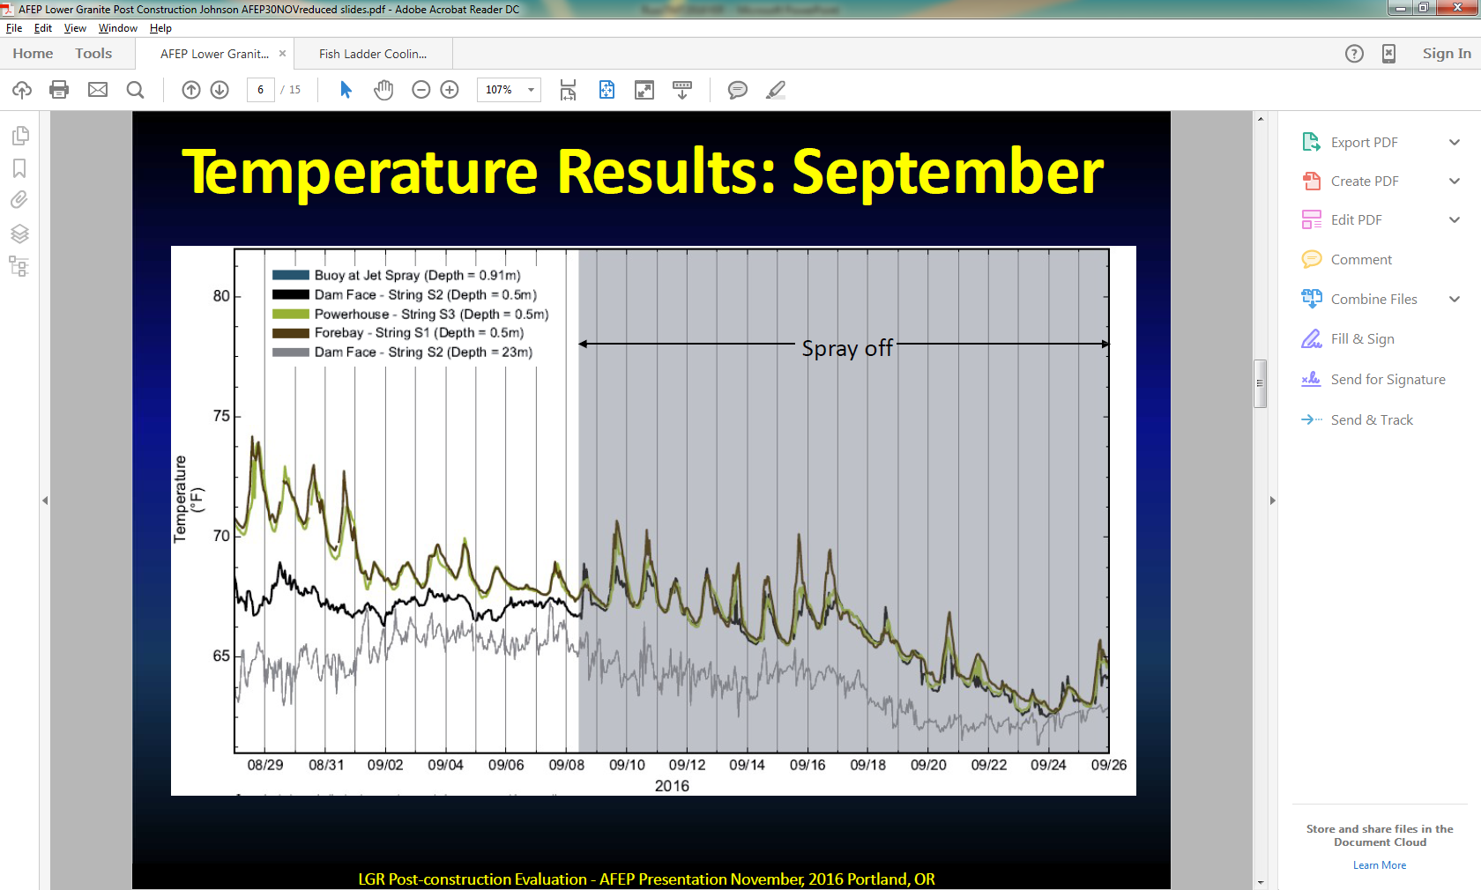

Slide 13
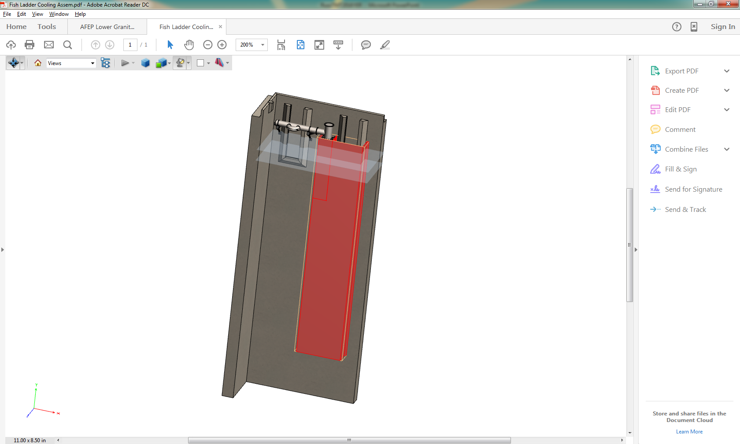
Little Goose Dam
Ladder Cooling Systems
Rental Pumps 2016 & 2017
To Right is Initial Design of Permanent Structure for 2018

Slide 14
Table 1. Conversion rates (% Survival) for Snake River Sockeye Salmon from Bonneville to the Sawtooth Basin traps.
Average Survival
 | BON-TDA | TDA-MCN | MCN-IHD | IHD-LMO | LMO-LGO | LGO- LGR | LGR-BASIN
(08-14)* | 84% | 78% | 98% | 99% | 97% | na | 55%
2015 | 63% | 24% | 61% | 81% | 66% | 82% | 26%
2016 | 87% | 84% | 98% | 98% | 98% | 98% | 60%
*2008-2014 data obtained from Crozier et al. (2015).

Slide 15
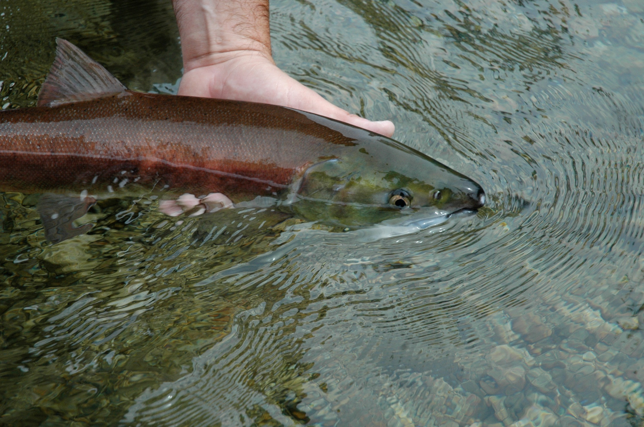
Adult Questions?

